Slide 1
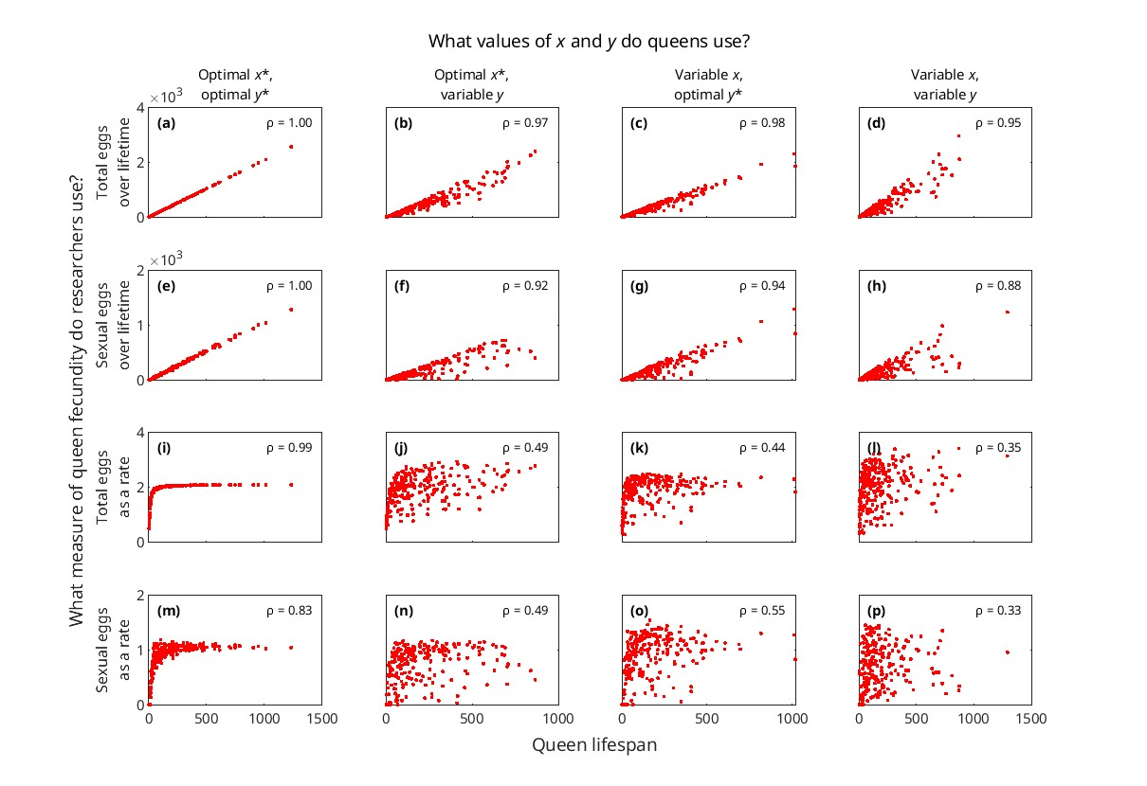
Figure 3 without seasonality, with maxmax to find optimal values.

Slide 2
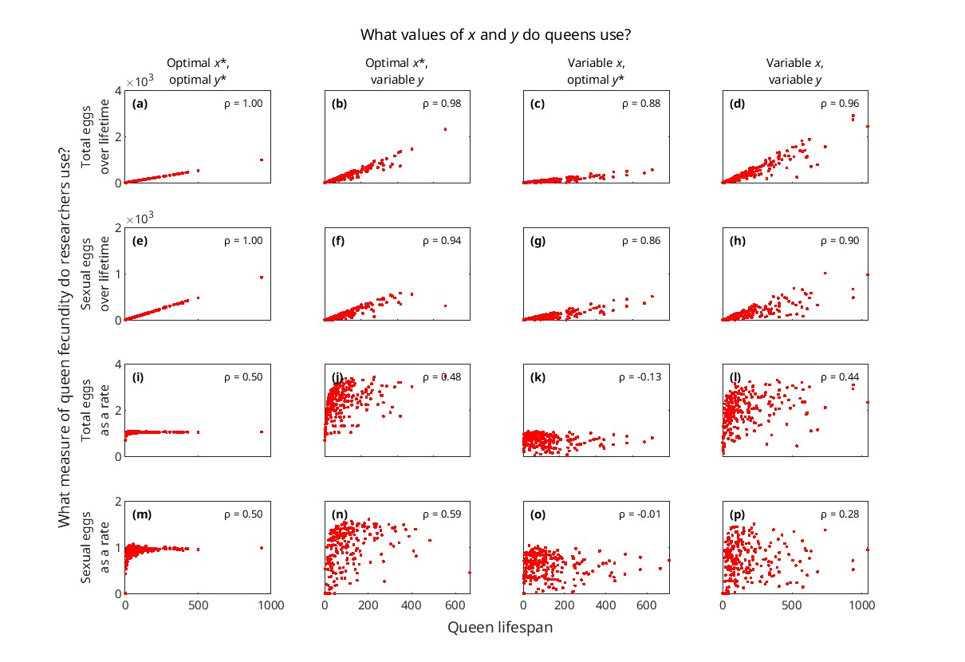
Figure 3 without seasonality, with poly (degree = 2) to find optimal values.

Slide 3
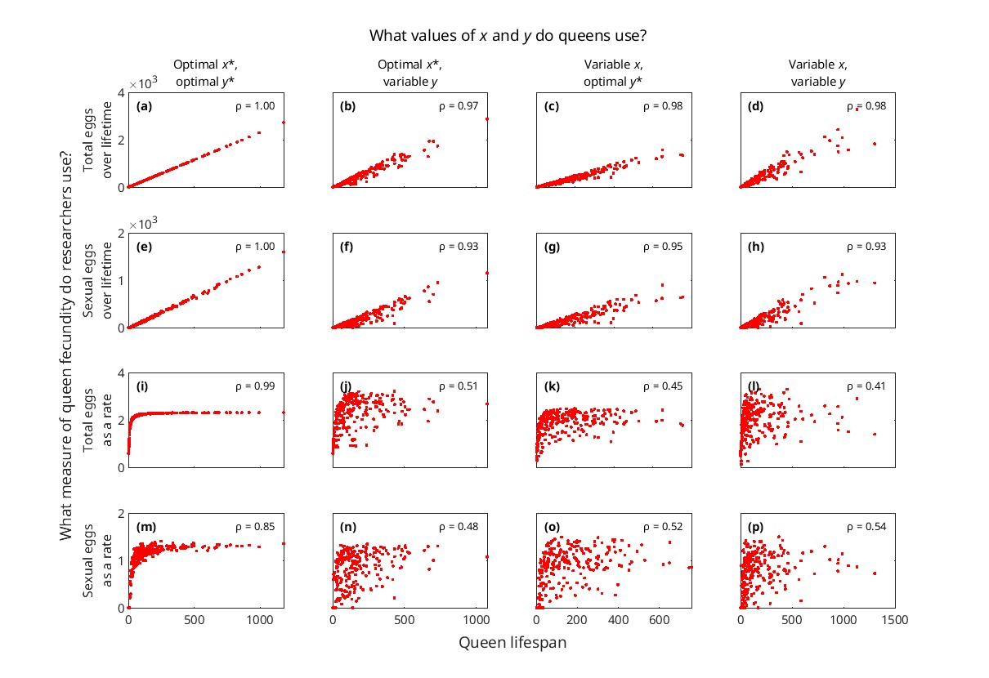
Figure 3 without seasonality, with poly (degree = 3) to find optimal values.

Slide 4
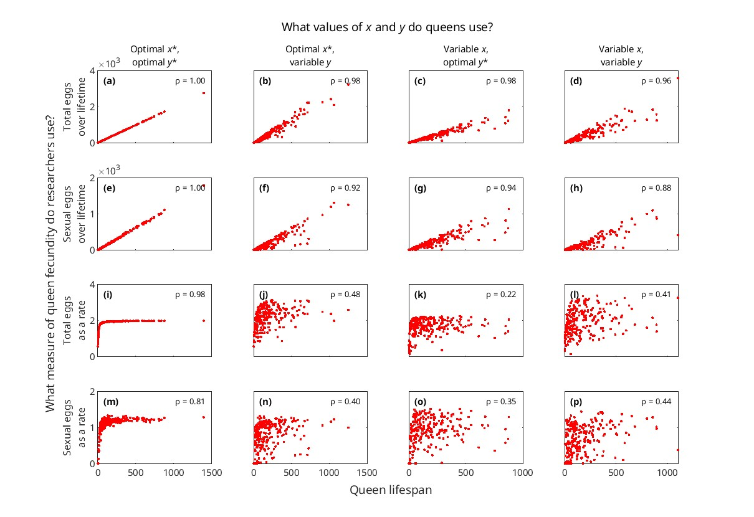
Figure 3 without seasonality, with csaps to find optimal values.

